Slide 1
History of Botulism
First discovered in 1793 as foodborne botulism by Justinus Kerner, a German physician.
Associated with spoiled sausage and aptly named botulism after the Latin word for sausage, botulus.
In 1897, Emile von Ermengen was able to correlate Clostridium botulinum to the disease.

Slide 2
Outbreaks of Botulism
January 1998, Buenos Aires, Argentina. Nine of 21 bus drivers developed foodborne botulism.
Symptoms included acute cranial nerve dysfunction including ptosis, dysphagia, blurred vision, motor weakness, respiratory failure.
Attributed to matabre, which was boiled at 78-80ºC for four hours, sealed in plastic wrap, and inadequately refrigerated.
Not adequately cooked, stored in anaerobic environment, and refrigerated only at 10ºC.
No fatalities

Slide 3
Outbreaks of Botulism
One case of foodborne botulism from beef stew in Arkansas, June 1994.
progressive dizziness, blurred vision, slurred speech, difficulty swallowing, and nausea
patient was hospitalized for 49 days, including 42 days on mechanical ventilation.

Slide 4
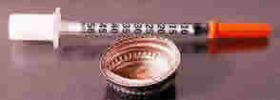
Outbreaks of Botulism
19 cases of wound botulism in California, 1995.
18 cases are associated with intravenous drug users.
2 cases reported the requirement of mechanical ventilation for 47 days.
Botulinal antitoxin and penicillin were administered.

Slide 5
Reported US Botulism Cases in 2001
Total of 169 cases of botulism intoxication
33 cases of foodborne botulism
112 cases of infant botulism
23 cases of wound botulism
1 case of adult intestinal colonization
3 fatalities

Slide 6
Foodborne Botulism
Arkansas saw 9 cases of foodborne botulism due to ingesting beaver.
Texas saw 16 related cases of foodborne botulism due to ingesting chili.
Other carriers were home canned foods, preserved fish, pickled pigs feet, and stink eggs.

Slide 7
Wound Botulism
22/23 cases reported resulted from intravenous drug users, mostly occurring in California.
One case resulted from a motor vehicle accident.

Slide 8
Distribution of Botulism Types
87 Type A- most common and the most potent
67 Type B
10 Type E
1 Type F

Slide 9
Introduction to the Bacteria
Clostridium botulinum
Bacteria
Width: 0.5—2.0 µm
Length: 1.6—22.0 µm
Occur naturally in soil, found in gastrointestinal tracts of animals as well as humans
Survival is dependent on:
Water
Anaerobic conditions
Notes:
Clostridium botulinum is a rod-shaped bacteria, as you see here.
Bacteria
Whose Width is between: 0.5—2.0 µm
and whose Length spans from: 1.6—22.0 µm
Occur naturally in soil, found in gastrointestinal tracts of animals as well as humans
Dependent on:
Water
Anaerobic conditions

Slide 10
Types of Botulinum Neurotoxins
C. botulinum → botulinum neurotoxin
(BoNT or Botox), most lethal substance!
100,000x to 3,000,000x more potent than sarin nerve gas
BoNT inhibits release of neurotransmitter:
ACh
4 genetically diverse types of the bacteria
Subdivided into: 7 distinct types
BoNT “A” to “G”
Types lack cross-neutralization by different antibodies
Proteolytic and Nonproteolytic strains
Notes:
C. Botulinum in its vegetative ( or non-spore form) produces its toxin intracellularly. This toxin is referred to as “BoNT,” or “Botox” and is released during autolysis of the cell.
→ BoNT inhibits release of neurotransmitter
This neurotoxin blocks the presynaptic release of the neurotransmitter acetylchololine (ACh) that is necessary for initiating muscle contractions.
There are 4 genetically diverse classifications. Further, these produce a total of 7 distinct serotypes. Each serotype responds to a specific antibody, while antibodies for another serotype cannot neutralize that toxin. These types are named BoNT A, BoNT B, all the way to BoNT G.
BoNTs can also be categorized as either proteolytic or nonproteolytic.
Proteolytic types SELF-activate the toxin by cleaving the inactive holotoxin, forming the active di-chain toxin.
Nonproteolytic types depend on the host’s proteases to cleave the holotoxin for activation.

Slide 11
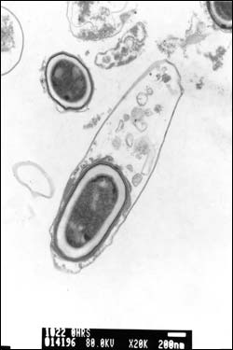
Growth
Gram-positive
Anaerobic
Temperature
Optimal: 40°C
Minimum:
Proteolytic: 10°C
Nonproteolytic: 3.3°C
Minimum pH
Proteolytic: 4.6
Nonproteolytic: 5.0
Water Activity (a_{w}): 0.94 (+NaCl controls growth)
Redox Potential (E): -350 mV
Notes:
The clostridium botulinum is gram-positive, meaning that the bacteria retains the stain during Gram's method of staining. This tells us something about the bacterial surface, suggesting that its cell wall is composed of a thick layer of peptidologlycan complexed to other molecules.
The bacteria thrives in anaerobic environments having an optimal temperature of 40 degrees celsius..
Its minimum temperature differs for two types. Proteolytic is 10 degrees celsius, and the nonproteolytic type can survive
in harsher conditions, able to live at 3.3 degrees celsius.
Minimum pH is 4.6 for proteolytic and 5.0 for nonproteolytic types.
C. Botulinum has a water activity of .94, compared to water having a 1.00 water activity.
This specifies the water content needed by the bacteria. Dehydration can thus limit its growth, but more
effective is to add a 10% NaCl solution.
Its redox potential is –350 mV.
This low E_{-350mv} is consistent with a low Oxygen environment, which the bacteria prefer
water activity: An expression of the relative availability of water in a substance. Pure water has an water activity of 1.000. The water activity of a solution is one-hundredth its relative humidity.
redox potential
<chemistry> The reducing/oxidizing power of a system measured by the potential at a hydrogen electrode.
Opioids—synthetic narcotics (Originally, agents that caused somnolence or induced sleep).

Slide 12
BoNTs’ Characteristics
Notes:
This table summarizes several characteristics of the BoNT serotypes.
BoNTs C & D can be slightly proteolytic or slightly nonproteolytic. Again, proteolytic means the botulinum can cleave and activate itself whereas nonproteolytic means it relies on the host to make the cleave.
Bacteriophage: These attack the bacteria and by doing so, they cleave the bacteria and activate its toxicity.
BoNT types A, B, E, & F have been linked to diseases in humans.
Types C & D cause diseases in other mammals and birds. However, these two may cause also affect humans because they cause food borne botulism in primates.
Types C, D & G in aerosol form also affected primates.

Slide 13
Human Botulism
3 Natural Forms:
Foodborne
Wound
Intestinal (infant and adult)
Manmade Form: Inhalation Botulism
Notes:
Botulism occurs in 3 natural forms. These are foodborne, wound, and intestinal botulism. The toxin enters circulation only through the gut or lung, or from a wound, and affects anaerobic tissue.
Payal will discuss the effects of these forms of botulism, and Robert will propose weaponization techniques for these types of botulism in a little while.

Slide 14
Structure of a BoNT
Light (L) Chain
Zinc-endopeptidase activity
specific for different protein
components of vesicle fusion.
50 kDa
Singh, B.R. (2000). “Intimate details of the most poisonous poison.” Nature Structural Biology. 7 617-619
Binds to nerve cells
Translocates L chain
Heavy (H) Chain: 3 domains
100 kDa total
Amino-terminal (H_{N})
Carboxy-terminal (H_{C})
Responsible for binding and penetration of specific cells
Disulfide bond links two polypeptide chains
Notes:
I will now discuss the microbiology of the botulinum toxin released by the bacteria.
The serotypes have different binding sites but generally the structure for
all has the same organization.
BoNT is composed of two chains, a light chain and a heavy chain.
→Light (WHICH IS THE BLUE): 439 residues; weighs 50 Kda
The L chain exhibits Zinc-dependent endopeptidase activity.
Each serotype cleaves one of 3 proteins of SNARE as I will show you later,
which form the synaptic vesicle docking and fusion complex.
The serotypes nevertheless has conserved regions in the amino terminal, central regions and two cysteines making up the disulfide bond.
→Heavy (is THE longer chain having 3 domains colored green,, red and yellow): has 843 residues; weighs 100 kDa total
Amino-terminal (H_{n}) in green & carboxy-terminal (H_{c}) in yellow.
→ Responsible for binding and penetration of specific cells
The Hc (yellow) domain attaches to the nerve cells. The Hn domain will be involved in translocating the L chain from the endosome and into the cytosol.
gangliosideA glycosphingolipid that contains one or more residues of N acetyl or other neuraminic acid derivatives.
Gangliosides are found in highest concentration in cells of the nervous system, where they can constitute as much as 5% of the lipid.
(18 Nov 1997)

Slide 15
3D Representation
Hanson, M. “Cocrystal structure of synaptobreven-II bound to BoNT/B.” Nature. 7, 687-692 (2000).
Notes:
Ribbon diagram of BoNT/A holotoxin. (Crystal type A).
In general, the three functional domains are structurally distinct. The exception is this loop in yellow, or
belt, which has been considered part of the translocation domain (Hn), that wraps around and hides the catalytic domain.
Access to the active site is gained by the loss of these interactions
upon separation of the catalytic domain from the rest of the
toxin.
The binding domain is colored dark green, the translocation domain gold, and the catalytic domain light blue. The catalytic domain active site loops are inpurple and the zinc ion is in green/yellow.

Slide 16
Living Conditions
Limiting Factors
Low pH (acidic)
In the stomach, BoNTs occur in complexes with other proteins that protect it from acidity
In the less acidic intestine, the complex disassociates and BoNT is then absorbed through the epithelial layer and enters the circulatory system
Nitrite, ascorbic acid, phenolic antioxidants, ascorbates
Increase in calcium level counters the effects of BoNTs A and E
Notes:
Now I’ll discuss the limiting factors.
→Low pH (acidic)
In the stomach, BoNTs occur in complexes with other proteins that protect it from acidity
In the less acidic intestine, the complex disassociates and BoNT is then absorbed through the epithelial layer and enters the circulatory system
Nitrite, ascorbic acid, phenolic antioxidants, ascorbates (WHICH are present in food preservatives).
Increase in calcium level counters the effects of BoNTs A and E

Slide 17
Living Conditions (continued)
Limiting Factors (continued)
Temperature
pH
Water activity: Dehydration or addition of NaCl
Redox potential: Oxygen
Competing microorganisms
C. botulinum spores: More resilient
Less susceptible to limiting conditions for the bacteria
Notes:
Limiting Factors (continued)
Temperature
pH
Water activity
Redox potential
Competing microorganisms
C. Botulinum forms spores when conditions are harsh. The bacteria is actually found in spore form in the soil and in aquatic environments.

Slide 18
The Smart Stuff
Structure:
Translated as a single chain precursor (pretoxin)
Cleaved to generate fully active neurotoxin composed of a light chain (LC) and heavy chain (H)
Light and heavy chains linked by single disulfide bridge
Light chain acts as an endopeptidase
When bridge is intact, BoNT has no catalytic activity

Slide 19
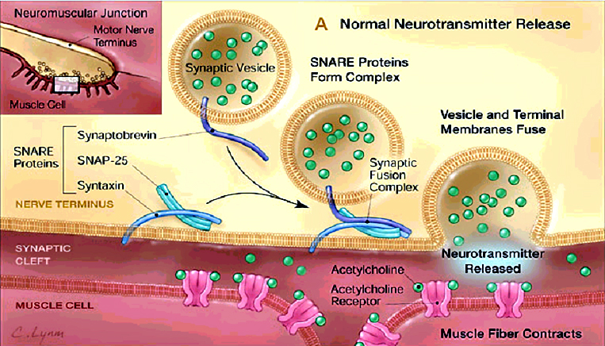
Normal Neurotransmitter Release at the NMJ
Arnon, S. et. al. “Botulinum Toxin as a Biological Weapon.” JAMA. 1059-70 (2001).
Notes:
Here is a picture of what happens in normal neurotransmitter release.
I have a movie clip that I will show you, but I’d like to point out the structures at the neuromuscular junction:
At the junction, this is the motor nerve neuron and the muscle cell.
1. SNARE proteins allow vesicles containing neurotransmitters to fuse with the presynaptic membrane.
---Synaptobrevin (or VAMP) is on the vesicles, which forms a complex with proteins in the presynaptic membrane called SNAP-25 and Syntaxin.
2. Synaptic Cleft where neurotransmitters are released and which then diffuse into:
3. Ach receptors on the postsynaptic membrane of the:
4. muscle cell.

Slide 20
BoNTs Affect:
Botulinum Neurotoxins act in the peripheral nervous system.
Neuromuscular junction (NMJ)
Parasympathetic cholinergic blockade
Notes:
Botulinum Neurotoxins act in the peripheral nervous system.
Neuromuscular junction (NMJ)
Parasympathetic cholinergic blockade

Slide 21
Mechanism
Binding & Internalization
Membrane Translocation
Enzymatic Target Modification
Notes:
The mechanism for intoxication occurs in 3 steps:
1. Binding & Internalization
2. Membrane Translocation
3. Enzymatic Target Modification

Slide 22
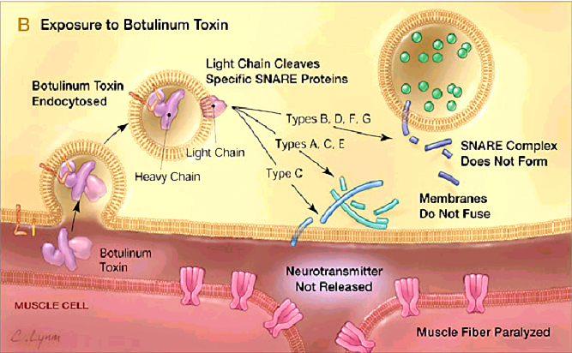
Exposure to BoNT
Behaviorism and mentalism are two theories that involve the mind, but one is based on empirical observation and the other is based on pure belief. Behaviorism is a topic that you learn about in a psychology course, a theory that behavior is in response to conditioning without regard to feelings, and mentalism, a theory based on mental perception and thought processes, can be learned through experience or through an apprenticeship with an experienced mentalist.
Arnon, S. et. al. “Botulinum Toxin as a Biological Weapon.” JAMA. 1059-70 (2001).
Notes:
Here’s a general picture of the mechanism of botulinum neurotoxin, which blocks the release
of neurotransmitters.
I’m going to discuss the steps FIRST and then show you a movie clip which will clarify the mechanism.

Slide 23
Binding
Binding
Binds irreversibly
“Double receptor binding”
H_{C} chain binds to negatively charged lipids
Becomes attached to the membrane surface
Moves laterally to a protein receptor (“R”)
Its carboxyl-terminal domain binds to “R”
Protein receptor
Specifies which serotype of the toxin binds to itself
Montecucco & Schiavo. “Structure and Function of tetanus and botulinum neurotoxins.” Quarterly Reviews of Biophysics. 1995, 436 423-472
Notes:
The toxin binds irreversibly to proteins receptors on the membrane surface.
In what is called the “Double receptor binding,”
The Heavy chain’s carboxy-terminal domain (Hc) binds to negatively charged lipids and attaches to the membrane surface
of the terminal axon.
It then Moves laterally to a protein receptor (“R”)
Its carboxyl-terminal domain binds to “R”
Protein receptor:
Specifies which serotype toxin binds to itself
In vitro, BoNT → can bind to nonneuronal cells in high concentrations
Presynaptic membrane has many polysialogangliosides
BoNT binds to negatively-charged surfaces (like these?)
In vivo, not clear that polysialogangliosides directly bind:
BoNT & gangliosides: no specific stoichiometry
Adsorb: Refers to the process of one material attracting and holding molecules of another substance to the surface of its molecules.
binding is bypassed:
If Injection into cells results in inhibition of manyexocytotic events
Lab: when sialic acid residues are removed toxin binds less (SB).

Slide 24
Internalization
Endocytosis
Botulinum toxin internalized through receptor-mediated endocytosis
Protein receptor & toxin inside endosome
Notes:
Botulinum toxin internalized through receptor-mediated endocytosis
Protein receptor & toxin inside endosome

Slide 25
2. Translocation
Singh, B.R. (2000). “Intimate details of the most poisonous poison.” Nature Structural Biology. 7 617-619
Acidic environment required for intoxication
pH allows translocation
from vesicle lumen
to cytosol
Interference with
intracellular vesicular
acidification inhibits toxicity.
H chain acts as a channel
L chain dissociates, and exits endosome
through channel
Notes:
Acidity in the endosome is thought to trigger a conformational change in the
Neurotoxin’s Heavy chain’s amino-terminal region (?). If you remember, that was the Hn-domain, the translocation domain. It can then form an ion channel.
→These changes are thought to expose amphipathic regions that penetrate the endosomal membrane, enabling release of the catalytic domain into the
cytosol of the neuron.
Hn- chain may form a channel that allows the
L chain to exit endosome
through channel
The reduction may expose the Zinc catalytic site, which is required to cleave the SNARE proteins.
Once released into the cytosol, the toxin cleaves one of
the three synaptic vesicle fusion proteins that enable synaptic vesicle exocytosis.
→ BLC
The 250 loop (residues 247–263) moves 18 Å away from the active site region in the BoNT/B-LC structure, burying
hydrophobic residues that were exposed as a result of separation from the translocation domain of the holotoxin. These changes
facilitate substrate binding by exposing the binding surface on the catalytic domain. The movement of loop 250 also causes a 4 Å
shift in the position of the catalytic loop (BoNT/B residues 367–381), priming the toxin for proteolysis by correctly positioning
key residues in the active site.
The membrane interaction and pore formation is thought
to facilitate the passage of the catalytic domain across the membrane
into the cytosol. The details of how the translocation
domain changes conformation at acidic pH to form a pore and
how it can allow for the passage of a 50,000 Mr catalytic domain
across the endosomal membrane are the least understood
aspects of the intoxication mechanism. (1998 Paper)

Slide 26
3. Catalytic Activity
L chain acts as endopeptidase
SNARE secondary recognition (SSR) sequence is nonspecific
A 9 amino acid sequence found in all SNARE proteins
Spatial orientation & distance establishes specificity
Pellizzari et al. “Structural Determinants of the Specificity…” Journal of Biological Chemistry. (1996) 20353-20358
Notes:
Substrate recognition
Each serotype is known to require substrates
of a minimum length and sequence. This includes the substrate’s cleavage point and a nine residue
region called the SNARE secondary recognition (SSR) sequence. All serotypes recognize this sequence.
Specificity due to SSR recognition AND correct spatial orientation.
As you see in this drawing, these boxes are the SSR sequences, and there are two on VAMP and syntaxin and four on SNAP-25.
→So, a serotype, will recognize these sites and whichever binds all will be able to stay there
and cleave specific sites on the serotypes.
As you can see, the serotype F would cleave here______, and serotype D here_____
The SSR sequence is found in at least two locations in each neuronal synaptic vesicle fusion protein. Botulinum neurotoxin
binding to an SSR sequence is highly nonspecific; each serotype is able to bind all SSR sequences regardless of substrate
specificity. However, substrate cleavage occurs only upon binding the SSR sequence that is the correct distance away from
the bond.
The active site of the clostridial neurotoxins is centered around a catalytic and structural zinc cation coordinated by a strictly conserved
HEXXH+E motif. In the case of BoNT/B-LC, zinc is directly coordinated by His 229 and His 233, which are located
on the same helix. The fourth ligand is a water molecule that also forms a strong hydrogen bonding interaction with Glu 230. The

Slide 27
Catalytic Cleavage
Cleaves one of 3 SNARE proteins:
Synaptobrevin (VAMP) on vesicle
SNAP-25
Syntaxin
Neurotransmitter vesicles cannot fuse with presynaptic membrane→ Paralysis
Notes:
→Cleaves one of 3 SNARE proteins:
Synaptobrevin (VAMP) on vesicle
SNAP-25
Syntaxin

Slide 28
L-chain’s Binding Specificity
Notes:
Here’s a table showing the protein component of the SNAP complex that is cleaved by the Botulism neurotoxins.

Slide 29
BoNTs cleave SNAREs
Humeau, Y., F. Doussau, et al. (2000). “How botulinum and tetanus neurotoxins block neurotransmitter release.” Biochimie 82: 427-446.

Slide 30
Category A Biological Agents are designated as high-priority because they:
can be easily disseminated or transmitted between individuals
have a high lethal factor, and show potential to affect public health
have potential to cause panic or disruption in society
require particular actions to be taken for public health preparedness
Notes:
Botulism can affect individuals of any age, nationality, gender.
Toxoid = inactive toxin

Slide 31
Four forms of botulism are distinguished by their modes of transmission
Foodborne – anaerobic conditions in inadequately preserved/processed food allows for C. botulinum growth; spores germinate within food
Wound – anaerobic conditions within abscessed wound allows production of toxin by C. botulinum
Intestinal – anaerobic conditions within intestinal lumen allows toxin production by C. botulinum (spores germinate within intestinal cells; neurotoxin released into gut during autolysis)
Infant – primary victims
Adult
Inhalational – only man-made (aerosolized) form of toxin; most likely candidate for bioterrorist attacks

Slide 32
Pathogenesis
Absorbed into bloodstream via mucosal surface (in digestive system) or wound, since unable to penetrate intact skin
To peripheral neurons at myoneural junctions
To cholinergic receptors to inhibit ACh release ➔ paralysis
Notes:
Dyspnea = shortness of breath

Slide 33
Incubation Periods & Specific Symptoms vary with mode of transmission
Foodborne –
18-36 hr incubation period
gastrointestinal symptoms precede/accompany bulbar palsies
Intestinal –
8-22 day incubation period
GI symptoms, as with foodborne
Wound –
4-21 day incubation period
GI symptoms absent
Notes:
Foodborne: gastrointestinal symptoms include abdominal pain, nausea, vomiting, diarrhea
Inhalational botulism incubation period unknown because only few cases have ever been cited – neurological symptoms showed 72 hours after exposure, but amount of toxin unknown

Slide 34
Botulism symptoms: Characteristic Triad
Symmetric, descending (cranial nerves first, then upper extremities, then respiratory muscles, and lower extremities) flaccid paralysis with prominent bulbar palsies, particularly:
Diplopia – double vision
Dysarthria – difficulty in speech articulation
Dysphonia – difficulty in voice production
Dysphagia – difficulty in swallowing
Patient is afebrile (although fever may be present in wound botulism)
Patient’s sensibilities intact; cognitive functions unaffected
Notes:
Bulbar = pertaining to medulla oblongata
Sensibilities intact ➔ cognitively alert & aware
Arrested autonomic functions marked by symptoms such as dry mouth, sore throat, are also strong BoNT indicators

Slide 35
Signs of Food-borne and Wound Botulism
Ventilatory (respiratory) problems
Eye muscle paresis/paralysis (extraocular, eyelid)
Dry mucous membranes in mouth/throat
Dilated, fixed pupils
Ataxia
Hypotension
Nystagmus
Decreased to absent deep tendon reflexes
A. Patient at rest. Note bilateral mild ptosis, dilated pupils, disconjugate gaze, and symmetric facial muscles.
B, Patient was requested to perform his maximum smile. Note absent smile creases, ptosis, minimally asymmetric smile.
Notes:
Paresis = slight/incomplete paralysis
Ataxia = failure of muscular coordination
Hypotension = low blood pressure
Nystagmus = An involuntary, rapid, rhythmic movement of the eyeball, which may be horizontal, vertical, rotatory or mixed, i.e., of two varieties.
Tendon = muscle to bone

Slide 36
Clinical Features of Infant Botulism
Ventilatory difficulty
Weakness/hypotonia
Poor oral feeding/weak sucking
Weak cry
Poor head control
Lethargy/somnulence
Ocular abnormalities (mydriasis, ptosis)
Cardiovascular abnormalities (hypotension, tachycardia)
Notes:
Hypotonia = diminished tone of skeletal muscles
Mydriasis = long, continued dilation of pupil
Ptosis = The drooping of the upper eyelid from paralysis of the third nerve or from loss of sympathetic innervation.
Tachycardia = high heart rate
Notice that clinical signs of botulism are difficult to recognize, or distinguish from general infant characteristics, need to confirm presence of organisms in fecal cultures/serum

Slide 37
Clinical Perspective of Clostridium botulinum
There are four types of botulism, characterized by the method of delivery of the toxin.
The toxin cannot pass through the skin, thus, transmission requires a break in the skin or direct absorption through mucus membranes in the lungs or GI tract.
Foodborne botulism is the result of the ingestion of food contaminated with Clostridium botulinum containing the preformed toxin. Note: Ingestion of the toxin makes a person ill, not Clostridium botulinum itself.

Slide 38
Wound botulism occurs when a break in the skin becomes infected with Clostridium botulinum which then multiply and release botulism toxin into the blood.
Inhalation botulism occurs when aerosolized botulism toxin enters the lungs.
Infant botulism is the result of the infestation of the digestive tract with Clostridium botulinum.

Slide 39
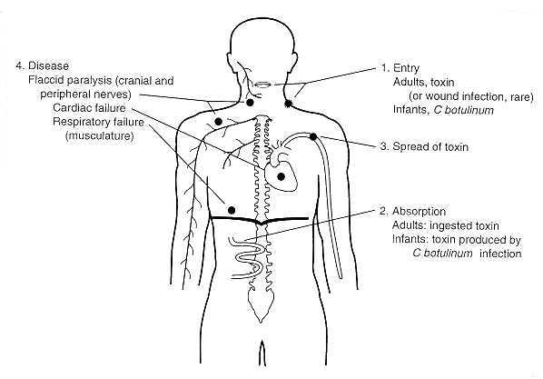

Slide 40
Roughly 100 cases of botulism are reported in the U.S. each year.
Approximately 25% are foodborne, 72% are infant botulism, and the remaining 3% are wound botulism.
Inhalation cases do not occur naturally.

Slide 41
In infant botulism, illness results from infestation of the GI tract with Clostridium botulinum. Such infestation is generally not an issue in individuals older than one year due largely to the large number of competing microorganisms found in the mature GI tract.

Slide 42
Wound botulism is on the rise due to an increase in the use of black tar heroin. The source of the botulism could be the drug itself, a cut in the drug, dirty injection equipment, or contamination during the preparation process.

Slide 43
If left untreated symptoms may expand to include paralysis of respiratory muscles as well as the arms and legs.
Asphyxiation due to respiratory paralysis is the most common cause of death in botulism cases.

Slide 44
Botulism results in death in approximately 8% of documented cases. The key to survival is early diagnosis. For the period 1899-1949 the case fatality ratio was approximately 60%. For the Period 1950-1996 the case-fatality ratio was 15.5%.
This improvement is largely attributable to improvements in respiratory intensive care and availability and prompt administration of the antitoxin.

Slide 45
Treatment
Antitoxin can halt the progress of symptoms if administered early to victims of food and wound botulism.
Antitoxin is not given to victims of infant botulism because when this is diagnosed it is generally too late for the antitoxin to do any good.

Slide 46
Treatment
Wound botulism is treated surgically to remove the Clostridium colony.
Artificial respiration is required if paralysis reaches the lungs. Such respiratory assistance may be required for weeks to months.
The paralysis induced by the toxin slowly improves over the course of many weeks.
Many patients make close to a full recovery following weeks to months of intensive care, however, lingering effects such as fatigue and shortness of breath may linger for years.

Slide 47
Treatment
Attempts to develop an effective botulism vaccine date back to the 1940’s. One current effort (now moving into clinical trials) uses injection of a non-toxic carboxy-terminus segment of the botulism toxin to confer immunity to the toxin.

Slide 48
Prevention
Proper food preparation is one of the most effective ways to limit the risk of exposure to botulism toxin.
Boiling food or water for ten minutes can eliminate some strains of Clostridium botulinum as well as neutralize the toxin as well. However, this will not assure 100% elimination.
Limiting growth of Clostridium botulinum and the production of botulism toxin is an alternative to their outright destruction.

Slide 49
Temperature, pH, food preservatives, and competing microorganisms are among the factors that influence the rate and degree of Clostridium botulinum growth.
Growth of most strains of Clostridium botulinum will not occur below 10 or above 50 degrees Celsius.

Slide 50
Clostridium botulinum will not grow in media with pH values lower than about 5.
Food preservatives such as nitrite, sorbic acid, parabens, phenolic antioxidants, polyphosphates, and ascorbates inhibit the growth of the microorganism.

Slide 51
Lactic acid bacteria including Lactobacillus, Pediococcus, and Pactococcus can inhibit the growth of Clostridium botulinum by increasing the acidity of the medium.
While the cause of roughly 85% of infant botulism cases is unknown, in up to 15% of infant botulism cases the causes was ingestion of honey. Infants younger than one year old should not be fed honey.

Slide 52
Avoiding Exposure
Avoid home-processed foods if at all possible, especially those with a low salt and acid content.
Botulism toxin is destroyed at a temperature of 176 F, thus if you must eat home-processed foods, boil them for 10 minutes before eating if at all possible.
If canning vegetables, use a pressure cooker, as it will kill any spores because it can reach temperatures above boiling.

